Slide 1

CARC103 – Computer Architecture
Kent Institute Australia Pty. Ltd.
ABN 49 003 577 302 CRICOS Code: 00161E RTO Code: 90458 TEQSA Provider Number: PRV12051

Slide 2
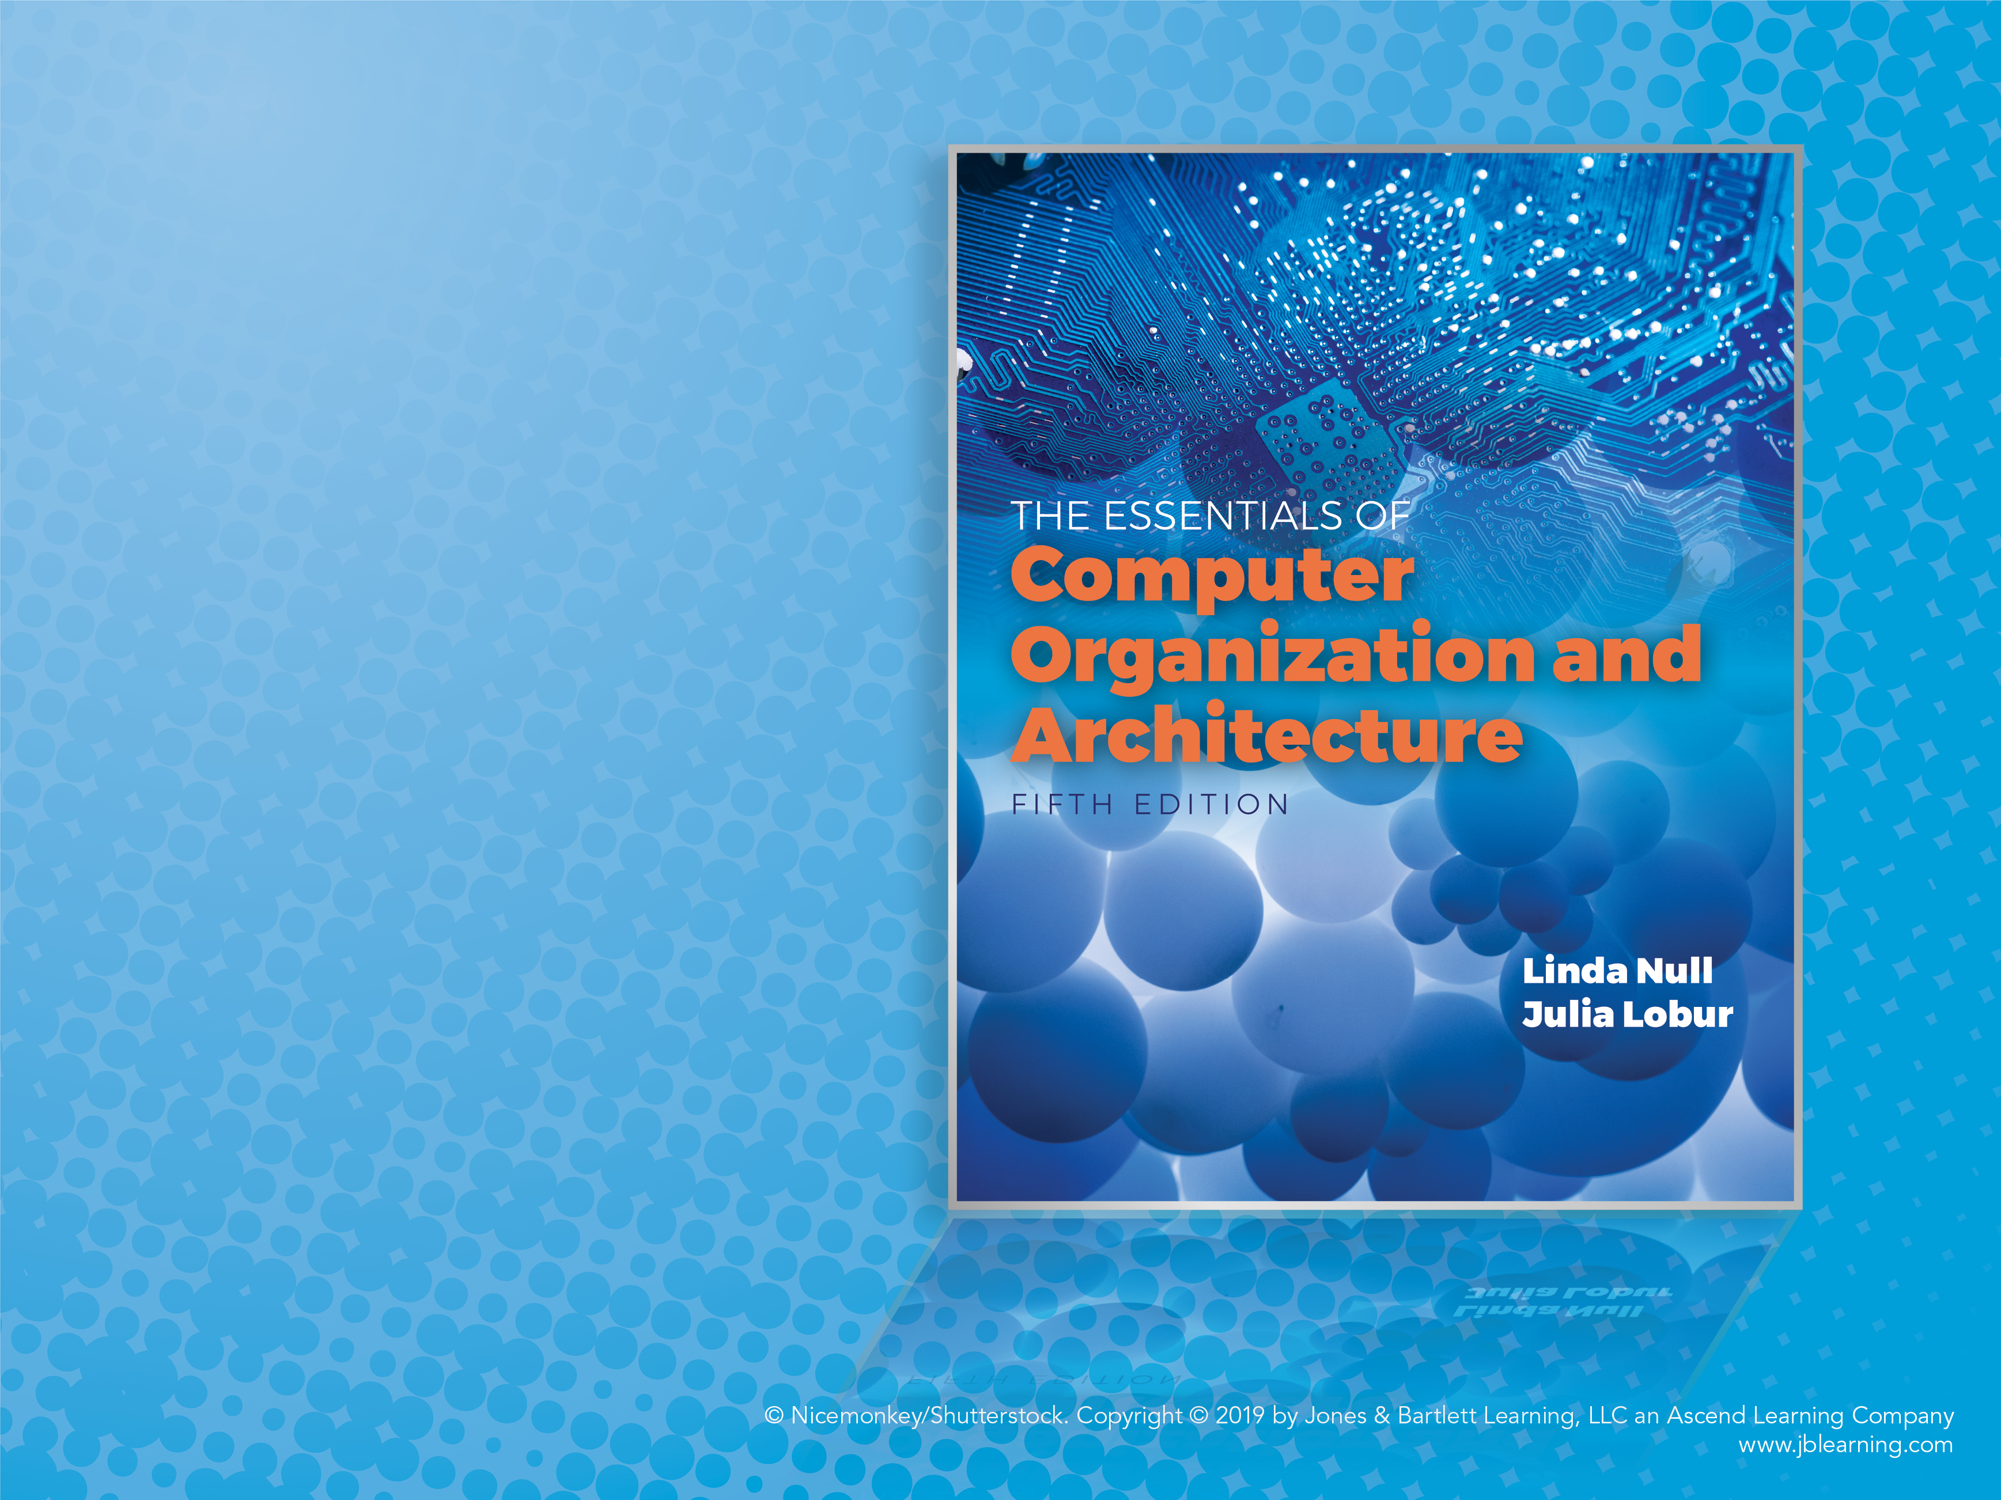
Chapter 4 Part 1
MARIE: An Introduction
to a Simple Computer

Slide 3
Objectives
Learn the components common to every modern computer system.
Be able to explain how each component contributes to program execution.
Understand a simple architecture invented to illuminate these basic concepts, and how it relates to some real architectures.
Know how the program assembly process works.
Notes:
প্রতিটি আধুনিক কম্পিউটার সিস্টেমের সাধারণ উপাদানগুলি শিখুন। প্রতিটি কম্পোনেন্ট কিভাবে প্রোগ্রাম এক্সিকিউশনে অবদান রাখে তা ব্যাখ্যা করতে সক্ষম হন। এই মৌলিক ধারণাগুলিকে আলোকিত করার জন্য উদ্ভাবিত একটি সাধারণ স্থাপত্য বুঝুন এবং এটি কীভাবে কিছু বাস্তব স্থাপত্যের সাথে সম্পর্কিত। প্রোগ্রাম সমাবেশ প্রক্রিয়া কিভাবে কাজ করে তা জানুন।

Slide 4
Introduction
Chapter 1 presented a general overview of computer systems.
In Chapter 2, we discussed how data is stored and manipulated by various computer system components.
Chapter 3 described the fundamental components of digital circuits.
Having this background, we can now understand how computer components work, and how they fit together to create useful computer systems.

Slide 5
CPU Basics
The computer’s CPU fetches, decodes, and executes program instructions.
The two principal parts of the CPU (Processor) are:
Data path (DP): consists of an Arithmetic-Logic Unit (ALU) and storage units (registers) that are interconnected by a data bus that is also connected to main memory.
Control unit (CU): is basically circuitry inside the CPU, controlling the operations inside the CPU.

Slide 6
CPU Basics
Registers hold data that can be readily accessed by the CPU.
They can be implemented using D flip-flops.
A 32-bit register requires 32 D flip-flops.
The arithmetic-logic unit (ALU) carries out logical and arithmetic operations as directed by the control unit.
The control unit determines which actions to carry out according to the values in a program counter register and a status register.

Slide 7
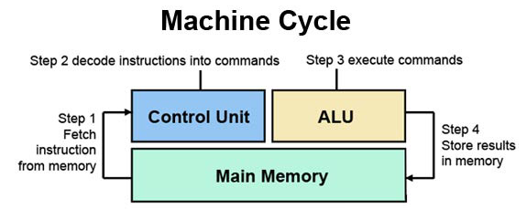
CPU Basics

Slide 8

Q : How does ALU know which function to perform?

Slide 9
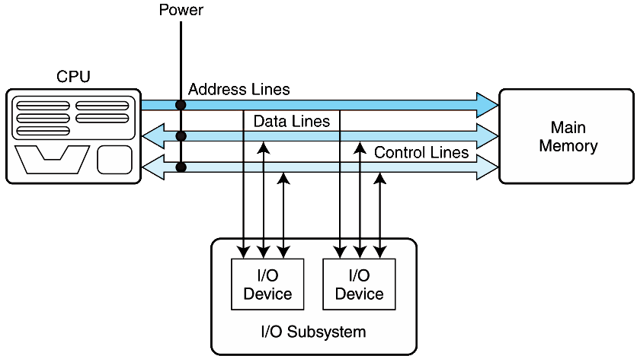
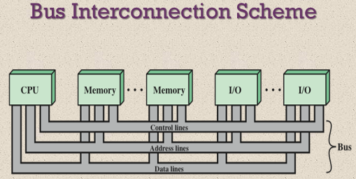
The Bus
The first Component of CPU is Buses (Data Paths). If one module wishes to send data to another, it must obtain the use of the bus, and transfer data via the bus.
If one module wishes to request data from another module, it must obtain the use of the bus, and transfer a request to the other module over the appropriate control and address lines. It must then wait for that second module to send the data.
Two types of buses are commonly found in computer systems:
point-to-point, and
multipoint buses.

Slide 10
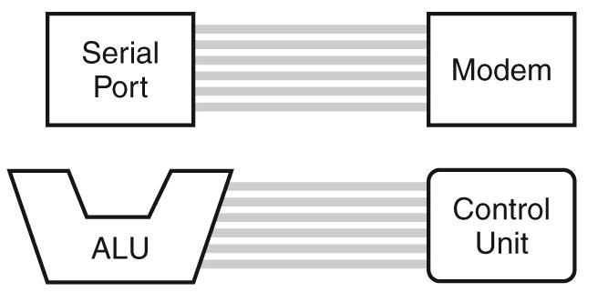
The Bus – Point-to-Point buses
Connecting two specific components.
Buses consist of data lines, control lines, and address lines.
While the data lines convey bits from one device to another, control lines determine the direction of data flow, and when each device can access the bus.
Address lines determine the location of the source or destination of the data.
The CPU transmits a variety of control signals to components and devices to transmit control signals to the CPU using the control bus.

Slide 11
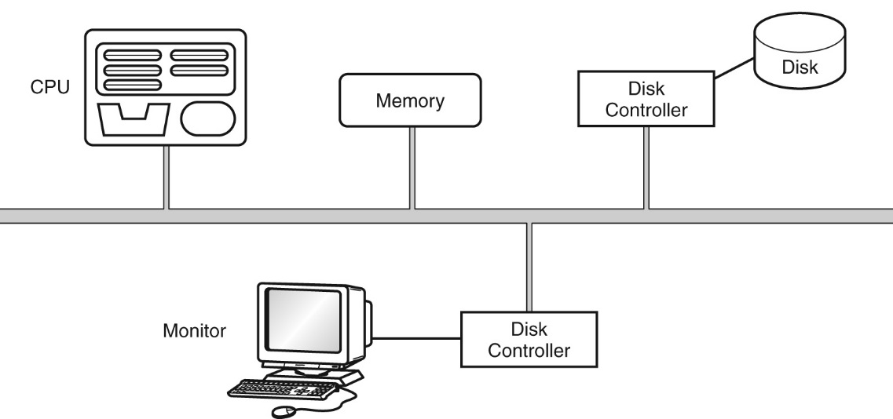
The Bus – Multipoint Bus
It is a common pathway connecting a number of devices, requiring these devices to share the bus. A multipoint bus is shown below.
Because a multipoint bus is a shared resource, access to it is controlled through protocols, which are built into the hardware.

Slide 12
Q : What is a point-to-point bus and a multi-point bus of a computer system? Sketch the schematic diagram of each bus.

Slide 13
The Bus - Bus Arbitration
In a single bus architecture when more than one device requests the bus, a controller called bus arbiter decides who gets the bus, this is called the bus arbitration.
Bus Arbitration is a way of sharing the buses in an optimal way so the faster devices won't have to wait to be able to transfer and the slower devices (like peripherals) will have a chance to transfer as well.
Different methods exist but two main types are the serial and parallel arbitrations.

Slide 14
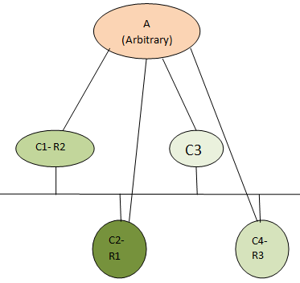
The Bus - Bus Arbitration
Daisy chain (Serial Arbitration): Permissions are passed from the highest-priority device to the lowest.
Centralized parallel: Each device is directly connected to an arbitration circuit.
Distributed using self-detection: Devices decide which gets the bus among themselves.
Distributed using collision-detection: Any device can try to use the bus. If its data collides with the data of another device, it tries again.

Slide 15
Q : Which type of bus arbitration is the least fair? Discuss why.

Slide 16
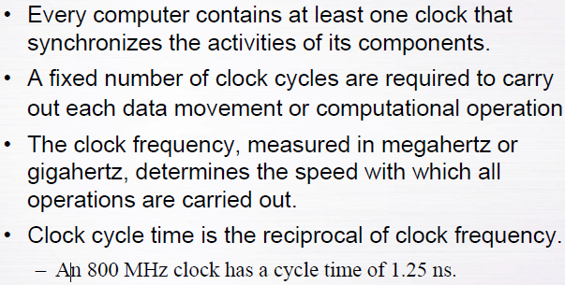
Clocks
Clock cycle time = 1/Frequency

Slide 17
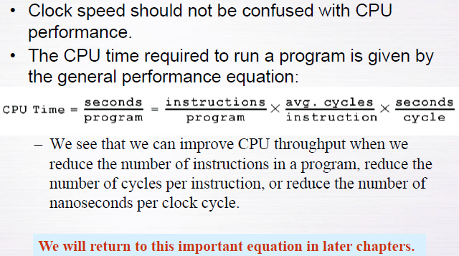
Clocks
Number of instructions per one program
Time required per one program
Average Number of cycles per one instruction
Time required per one clock cycle
= Frequency

Slide 18
Q : What is the difference between synchronous buses and asynchronous buses?

Slide 19
The Input/Output Subsystem
A computer communicates with the outside world through its input/output (I/O) subsystem.
I/O devices connect to the CPU through various interfaces.
I/O can be:
Instruction-based, uses CPU instructions that are specifically made for controlling I/O devices. These instructions typically allow data to be sent to an I/O device or read from an I/O device.
For example, the following are I/O instructions for ancient but popular Z80 8-bit CPU:
IN A, (04) ←- Input data to Register A from Port number 04
OUT (02), A ←- Output data from register A to Output port 02
Memory-mapped, uses normal CPU memory read/write instructions. The CPU writes data to a specific memory address, and to read from an I/O device, the CPU reads data from a specific memory address.
We study I/O in detail in chapter 7.

Slide 20
Memory Organization and Addressing
Memory is similar to a street full of apartment buildings.
Each Building (word) has multiple apartments (bytes), and each apartment has its own address.
All of apartments are numbered sequentially (addressed), from 0 to the total number of apartments in the complex minus one.
The buildings themselves serve to group the apartments.

Slide 21
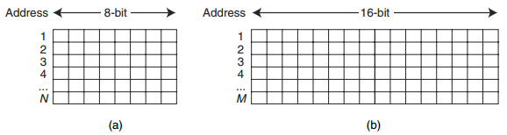
Memory Organization and Addressing
Computer memory consists of a linear array of addressable storage cells that are similar to registers.
Memory can be byte-addressable, or word-addressable, where a word typically consists of two or more bytes.
Byte-addressable means that each individual byte has a unique address.

Slide 22
Memory Organization and Addressing
Memory is constructed of RAM chips, often referred to in terms of
length (row) × width (column)
Number of blocks × Number of bits in each block
4M × 8 RAM chip gives us 4 megabytes of 8-bit memory locations.
4M x 8 means the memory is 4M long (it has 4M = 2² x 2²⁰ = 2²² words) and it is 8 bits wide. The width (second number of the pair) represents the word size.
To address this memory, we need to be able to uniquely identify 2²² different addresses. We need to count from 0 to (2²² - 1). How many bits does this required?
Note: 2¹⁰ = 1024 = 1 K, 2²⁰ = 1 M, 2³⁰ = 1 G, 2⁴⁰ = 1T

Slide 23
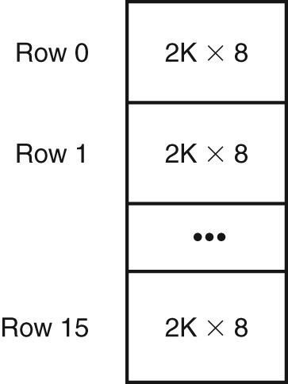
Memory Organization and Addressing
Example (3 - a):
Suppose we have a memory consisting of 16 2K x 8 bit chips. How Many bits (wires) are required for address bus?
Number of block in the Memory is 16 2K
= 32K
= 2⁵ × 2¹⁰ = 2¹⁵
Then, 15 bits are needed for each address.

Slide 24
Memory Organization and Addressing
Example (3 - b):
Suppose we have a memory consisting of 16 2K x 8 bit chips. How Many bits (wires) are required for address bus if the memory is byte addressable ?
Number of block in the Memory is 16 2K
= 32K
= 2⁵ × 2¹⁰ = 2¹⁵
1 byte for each block
Then, = 2⁵ × 2¹⁰ x 1 = 2¹⁵ = 2¹⁵
15 bits are needed for address bus

Slide 25
Memory Organization and Addressing
Example(1): How many bits are required to address a 4M × 16 main memory if
Main memory is byte-addressable?
1M = 2²⁰ , so 4M = 2² * 2²⁰ = 2²²
1 Byte = 8 bits; we have 16 bits that’s mean we have 2 Bytes
There are 4M 2 Bytes (2*8-bits byte):
4M * 16 = 4M * 2 Bytes = 2²² * 2 = 2²³
So, 23 bits are needed for an address
OR, 4M x 16 = 2² * 2²⁰ * 2⁴ = 2²⁶ bits
byte-addressable = 8 bits = 2³ bits
➔ 2²⁶ / 2³ = 2²³ bits are needed for an address
Main memory is word-addressable?
There are 4M Word:
1 word = 2 Bytes ; we have 16 bits (2 Bytes) that’s mean we have 1 word
4M * 16 = 4M * 1 Word = 2² * 2²⁰ * 1 = 2²²
So, 22 bits are needed for an address
OR, 4M x 16 = 2² * 2²⁰ * 2⁴ = 2²⁶ bits
word-addressable = 2 bytes = 2 * 8 = 2¹ * 2³ ⁼ 2⁴ bits
➔ 2²⁶ / 2⁴ = 2²² bits are needed for an address

Slide 26
Memory Organization and Addressing
Q1: How many bits would you need to address a 2M × 32 memory if
The memory is byte-addressable?
b) The memory is word-addressable?

Slide 27
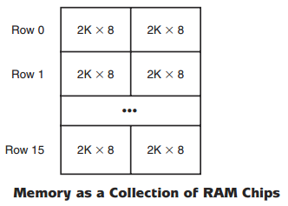
Memory Organization and Addressing
Main memory is usually larger than one RAM chip. Consequently, these chips are combined into a single memory module to give the desired memory size.
For example, suppose you need to build a 32K x 16 memory and all you have are 2K x 8 RAM chips. You could connect 16 rows (32/2=16) and 2 columns (16/8= 2) of Ram chips together as shown in Figure

Slide 28
Memory Organization and Addressing
Example(3) : Suppose that a 64M * 32 Memory built using 1024K*8 RAM Chips and memory is word addressable.
How many RAM Chips are necessary?
You need to know how many rows and columns of chips you need to connect together to build the memory
Number of rows = (64* 2²⁰) / (2¹⁰ *2¹⁰) = 64
Number of columns = 32 / 8 = 4
So we need 256 RAM chips (64 rows of 4 columns)
It can be solved in this way as well:
1024 = 2¹⁰
Number of rows = (64* 1024* 1024) / (1024* 1024) = 64
64M
1024K

Slide 29
Memory Organization and Addressing
Example(3) Cont ….
Suppose that a 64M * 32 Memory built using 1024K*8 RAM Chips and memory is word addressable.
b. How many RAM Chips are there per memory word?
This is equal to the number of columns = 4
(Since the chips are 8bits wide, and each memory location is 32bits wide, so 4 RAM chips will be selected for each address; means each memory word is spread into 4 RAM chip).
c. How many address bits are needed for each RAM Chip?
1024K = 2¹⁰ * 2¹⁰ = 2²⁰ bits
So, 20 bits (address line) are needed to address each RAM Chip.
K = 2¹⁰

Slide 30
Memory Organization and Addressing
Example(3) Cont ….
Suppose that a 64M * 32 Memory built using 1024K*8 RAM Chips and memory is word addressable
d. How many banks will this memory have?
This is equal to the number of rows = 64
e. How many address bits are needed for all memory?
64M = 2⁶ * 2²⁰ = 2²⁶ Bits
So 26 bits (address line) are needed to address all memory
M = 2²⁰

Slide 31
Memory Organization and Addressing
Q : Suppose that a 32K * 8 Memory built using 2K*8 RAM Chips and memory is word addressable.
How many RAM Chips are necessary?
b. How many RAM Chips are there per memory word?
c. How many address bits are needed for each RAM Chip?
d. How many banks will this memory have?
e. How many address bits are needed for all memory?

Slide 32
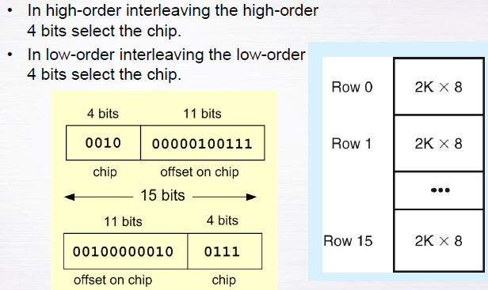
Memory Organisation
Single memory module – only one memory access can be performed at a time
Memory interleaving – splits memory across multiple memory modules (or banks), in which multiple banks can be accessed simultaneously.

Slide 33
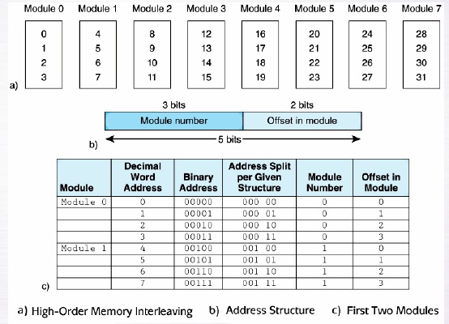
Memory Organisation

Slide 34
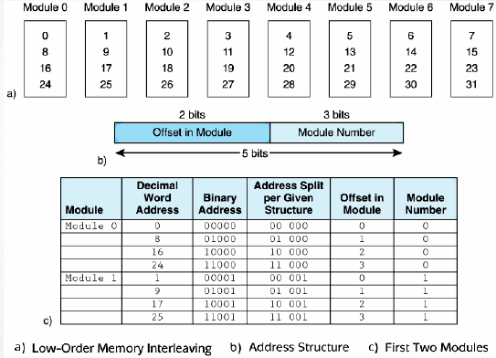
Memory Organisation

Slide 35
Memory Organisation
Q: Suppose we have a byte-addressable memory of 20 bytes, built using 4 modules. Draw diagrams showing the distribution of addresses within each module, if we are using (a) high-order interleaving, and (b) low-order interleaving.

Slide 36
Interrupts
The normal execution of a program is altered when an event of higher-priority occurs. The CPU is alerted to such an event through an interrupt.
Interrupts can be triggered by I/O requests, arithmetic errors (such as division by zero), or when an invalid instruction is encountered.
Each interrupt is associated with a procedure that directs the actions of the CPU when an interrupt occurs.
Non maskable interrupts are high-priority interrupts that cannot be ignored.

Slide 37
Interrupts
Q: Explain what the CPU should do when an interrupt occurs. Include in your answer the method the CPU uses to detect an interrupt, how it is handled, and what happens when the interrupt has been serviced.

Slide 38
MARIE
We can now bring together many of the ideas that we have discussed to this point using a very simple model computer.
Our model computer, the Machine Architecture that is Really Intuitive and Easy, MARIE, was designed for the singular purpose of illustrating basic computer system concepts.
While this system is too simple to do anything useful in the real world, a deep understanding of its functions will enable you to comprehend system architectures that are much more complex.

Slide 39
MARIE – Characteristics
The MARIE architecture has the following characteristics:
Binary, two's complement data representation.
Stored program, fixed word length data and instructions.
4K words of word-addressable main memory.
16-bit data words.
16-bit instructions, 4 for the opcode and 12 for the address.
A 16-bit arithmetic logic unit (ALU).
Seven registers for control and data movement.
How many bits are required for this 4K words of MARIE? – work out and check your answer on next slide.

Slide 40
MARIE - MARIE’s Seven Registers
MARIE’s seven registers are:
Accumulator, AC, a 16-bit register that holds a conditional operator (e.g., "less than") or one operand of a two-operand instruction.
Memory address register, MAR, a 12-bit register that holds the memory address of an instruction or the operand of an instruction.
Memory buffer register, MBR, a 16-bit register that holds the data after its retrieval from, or before its placement in memory.

Slide 41
4.8 MARIE - MARIE’s Seven Registers (Cont …)
Program counter, PC, a 12-bit register that holds the address of the next program instruction to be executed.
Instruction register, IR, which holds an instruction immediately preceding its execution.
Input register, InREG, an 8-bit register that holds data read from an input device.
Output register, OutREG, an 8-bit register, that holds data that is ready for the output device.

Slide 42
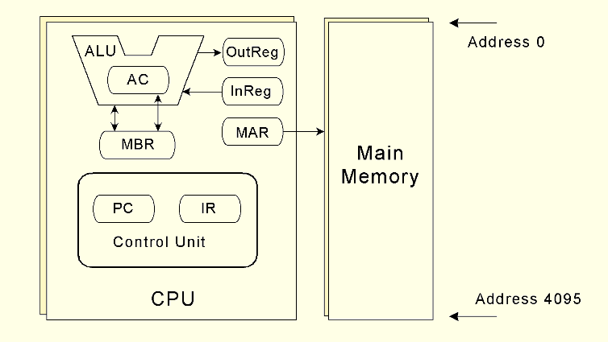
MARIE
This is the MARIE architecture shown graphically.
Notes:
Memory address register, MAR, a 12-bit register that holds the memory address of an instruction or the operand of an instruction. MARIE's memory is limited to 4096 address locations (2¹² = 4096), so the MAR only needs to be 12 bits wide to hold the largest address

Slide 43
MARIE - MARIE’s Seven Registers
Important Note:
MARIE can handle 16-bit data, so the AC must be 16 bits wide; as AC hold the operand that needs to implement the instruction.
However, MARIE's memory is limited to 4096 address locations (2¹² = 4096), so the MAR only needs to be 12 bits wide to hold the largest address; MAR, a 12-bit register

Slide 44
MARIE
A computer’s instruction set architecture (ISA) specifies the format of its instructions and the primitive operations that the machine can perform.
The ISA is an interface between a computer’s hardware and its software.
Some ISAs include hundreds of different instructions for processing data and controlling program execution.
The MARIE ISA consists of only thirteen instructions.

Slide 45
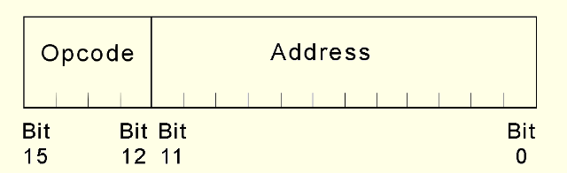
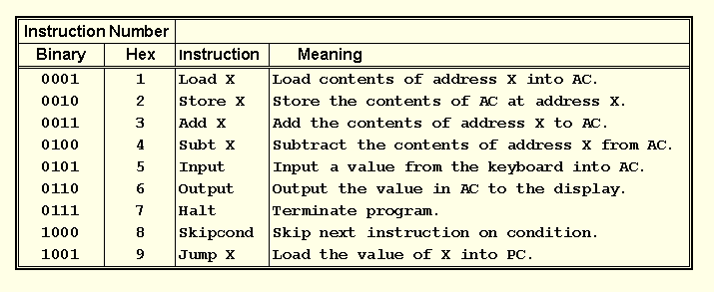
MARIE - Instruction Set Architecture (ISA)
This is the format of a MARIE instruction:
16-bit instructions, (4) for the opcode and (12) for the address
The fundamental MARIE instructions are:

Slide 46
MARIE - Instruction Set Architecture (ISA)
Q: Describe what each of the following MARIE instructions mean:
i. Load X
ii. Store X
iii. Jump X
iv. Halt
v. Add X

Slide 47
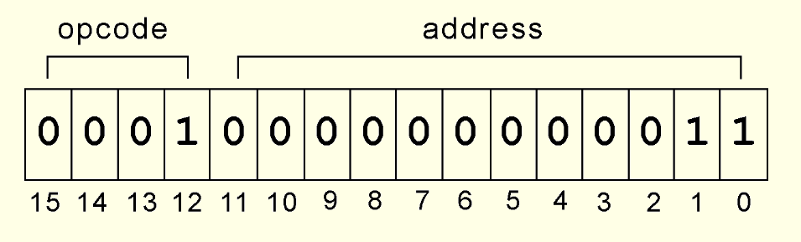
MARIE - Instruction Set Architecture (ISA)
This is a bit pattern for a LOAD instruction as it would appear in the IR:
We see that (0001000000000011):
the opcode is 1; means LOAD instruction
the address from which to load the data is 3.

Slide 48
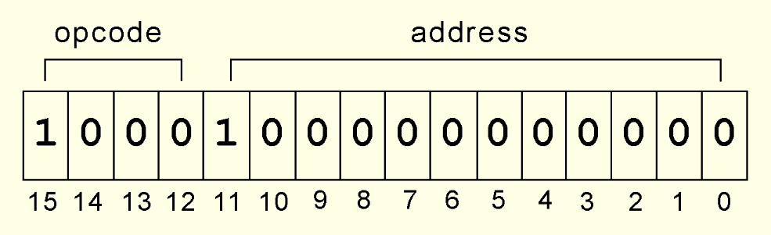
MARIE - Instruction Set Architecture (ISA)
This is a bit pattern for a SKIPCOND instruction as it would appear in the IR:
We see that
the opcode is 8; means SKIPCOND instruction
bits 11 and 10 are 10, meaning that the next instruction will be skipped if the value in the AC is greater than zero.
What is the hexadecimal representation of this instruction?

Slide 49
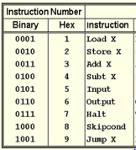
MARIE - Instruction Set Architecture (ISA)
Example (4): Write the assembly language equivalent of the following MARIE machine language instructions:
0111000000000000
0100111101001111
Answer:
Halt
Subt F4F

Slide 50
MARIE - Instruction Set Architecture (ISA)
Q4: Write the assembly language equivalent of the following MARIE machine language instructions:
0001101110010010

Slide 51
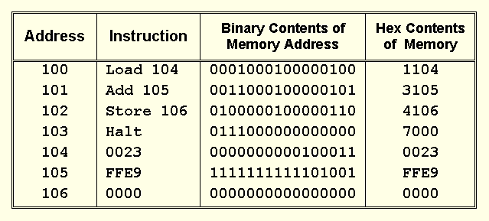
MARIE - Instruction Set Architecture (ISA)
Consider the simple MARIE program given below. We show a set of mnemonic instructions stored at addresses 100 - 106 (hex):

Slide 52
MARIE - Instruction Set Architecture (ISA)
Each of our instructions actually consists of a sequence of smaller instructions called microoperations.
The exact sequence of microoperations that are carried out by an instruction can be specified using register transfer language (RTL).
In the MARIE RTL, we use the notation M[X] to indicate the actual data value stored in memory location X, and ← to indicate the transfer of bytes to a register or memory location.

Slide 53
MARIE - Instruction Set Architecture (ISA) - Example(5)
A digital computer has a memory unit with 48 bits per word. The instruction set consists of 760 different operations. All instructions have an operation code part (opcode) and two address fields: one for a memory address and one for a register address. This particular system includes eight general-purpose, user-addressable registers. Each instruction is stored in one word of memory.
How many bits are needed for the opcode?
Each instruction is stored in one word of memory, and there is 48 bits per word.
Each instruction has 3 parts: Opcode, Memory address part, and Register.
We have 760 instructions and 8 registers. The length of each instruction is 48bits.
So, we need to find how many bits are needed to represent 760 opcodes. If we use 3bits, 2³ = 8, and 8 is not big enough to represent 760. We try to increase the 3 bits to other value till we reach the value is big enough to represent 760. We find 10 bits is enough to represent 760 opcode as
2¹⁰ = 1024.
Opcode | Memory | Register
760 | ? | 8
48 Bits Length

Slide 54
MARIE - Instruction Set Architecture (ISA) - Example(5) Cont ….
How many bits are left for the memory address part of the instruction?
First we need to find How many bits we have to specify registers. We have 8 Registers. To identify 8, We need 3 bits as 2³ = 8.
Bits are left for memory address = 48 – (10 + 3) = 35 bits
c) What are the maximum allowable size for memory?
Because of memory unit with 35 bits, so the maximum allowable size:
2³⁵
What is the largest unsigned binary number that can be accommodated in one word of memory?
Unsigned binary number because it is memory address, and the address should
not has signed value , this addresses start from 0 through 2⁴⁸ - 1. So the
maximum value of this address is 2⁴⁸ - 1.
2⁴⁸ - 1
Opcode | Memory | Register
760 | ? | 8
10 bits | 48 – (10 + 3) = 35 bits | 3 bits

Slide 55
MARIE - Instruction Set Architecture (ISA)
Q5: A digital computer has a memory unit with 32 bits per word. The instruction set consists of 110 different operations. All instructions have an operation code part (opcode) and two address fields: one for a memory address and one for a register address. This particular system includes eight general-purpose, user-addressable registers. Registers may be loaded directly from memory, and memory may be updated directly from the registers. Direct memory-to-memory data movement operations are not supported. Each instruction stored in one word of memory.
How many bits are needed for the opcode?
How many bits are needed to specify the register?
How many bits are left for the memory address part of the instruction?
What is the maximum allowable size for memory?
What is the largest unsigned binary number that can be accommodated in one word of memory?

Slide 56
MARIE - Instruction Set Architecture (ISA)
Q6: A digital computer has a memory unit with 24 bits per word. The instruction set consists of 150 different operations. All instructions have an operation code part (opcode) and an address part (allowing for only one address). Each instruction is stored in one word of memory.
How many bits are needed for the opcode?
b. How many bits are left for the address part of the instruction?
c. What is the largest unsigned binary number that can be accommodated in one word of memory?

Slide 57
Chapter 4 _ Part 2_ Cont ….

